Slide 1
Philosophy of Engineering
Unit - 2
Ontology of Engineering
Ontology - Reference Ontology and Application Ontology - - Suites of Ontology Modules - Functions and Capabilities - - Product Life Cycle - Commodities, Services and Infrastructure -
Practice 4: Reference Ontology using Concept/Mind Mapping
Practice 5: Engineering Application Ontology using Concept/Mind Mapping
Practice 6: Product Life Cycle Ontology using Concept/Mind Mapping

Slide 2
Ontology of Engineering
Onto – Existence, or being real
Logy – Science or Study
In philosophy, Ontology is the study of what exists or the nature of reality
Examples of philosophical, ontological questions are:
What are the fundamental parts of the world?
How they are related to each other?
Ontologies play important roles in knowledge representation and semantic interoperability within various domains

Slide 3
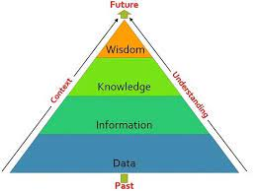
Ontology
provide knowledge support for modelling some domain of the world in terms of labelled concepts, attributes, and relationships usually classified in specialization/generalization hierarchies
A theory of being, which tries to explain the being itself, by developing a system of universal categories and their intrinsic relationships
Ontology components - concepts, properties, instances, axioms, etc

Slide 4
Reference Ontology:
Purpose: Reference ontologies, also known as foundational ontologies or upper-level ontologies,
aim to provide a high-level, abstract framework for organizing and categorizing knowledge.
They define basic concepts and relationships that can be used as building blocks for more specific ontologies.
Scope:
cover broad domains and are designed to be domain-independent.
They provide a foundational structure upon which application-specific ontologies can be built.
Examples:
include the Basic Formal Ontology (BFO), the Descriptive Ontology for Linguistic and Cognitive Engineering (DOLCE), and the Open Biological and Biomedical Ontologies (OBO Foundry).
Use Cases:
serve as a common framework for creating more specialized ontologies.
They provide a shared vocabulary and semantics to ensure interoperability among various ontologies and systems.

Slide 5
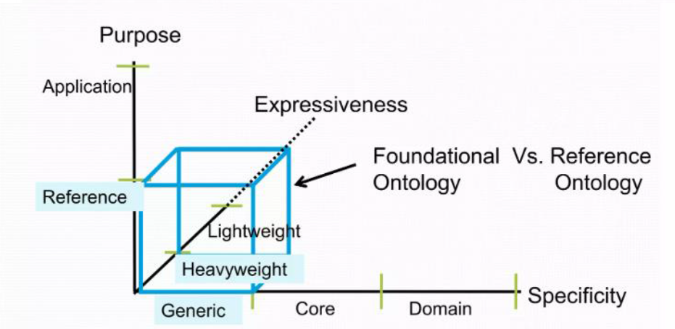
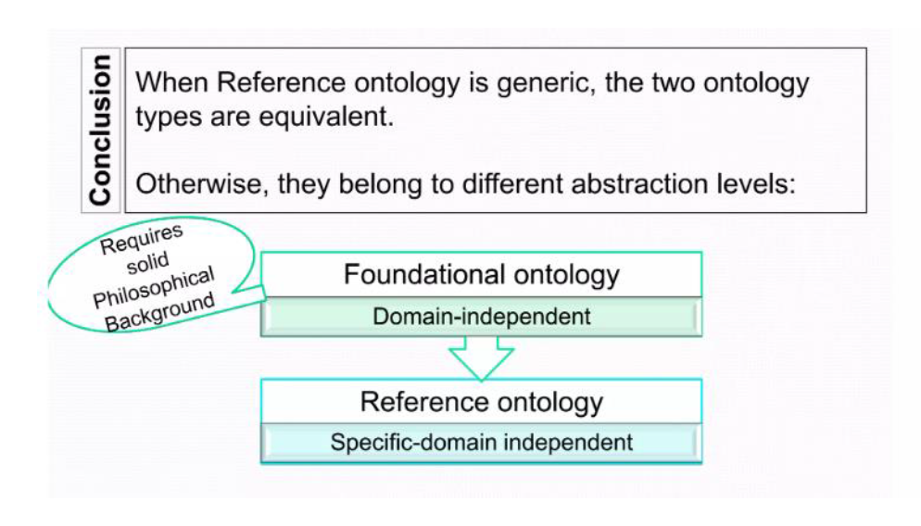
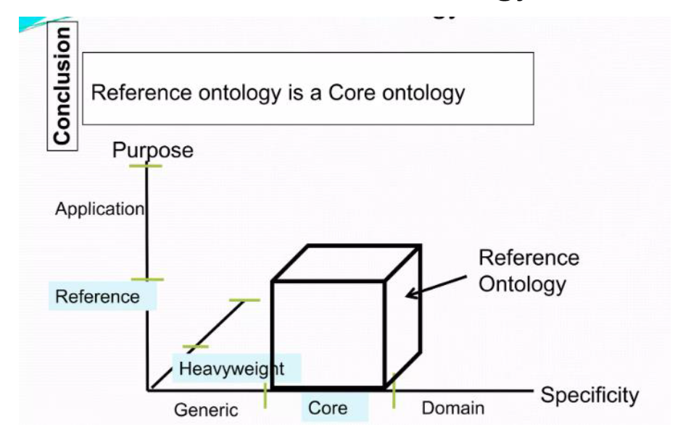

Slide 6
Application Ontology:
Purpose:
designed for specific applications or domains.
They provide a structured representation of knowledge tailored to address the needs of a particular field or problem.
Scope:
Application ontologies are domain-specific and focus on capturing detailed knowledge relevant to a specific context.
They often build upon reference ontologies but extend them with additional concepts, relationships, and rules specific to the application.
Examples:
Application ontologies can vary widely depending on their intended use.
For instance, a medical ontology might be developed to represent medical knowledge, while an automotive ontology could be created to model information related to the automotive industry.
Use Cases:
used to facilitate knowledge management, data integration, and reasoning within a specific domain.
enable better organization and retrieval of information, support data interoperability, and can be used in various applications, including search engines, expert systems, and data integration platforms.

Slide 7
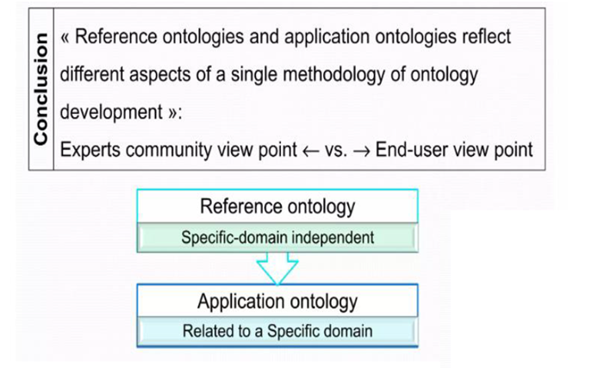
In summary, reference ontologies provide a foundational, domain-independent framework for ontology development, whereas application ontologies are domain-specific and tailored to address the knowledge representation needs of specific applications or fields.

Slide 8
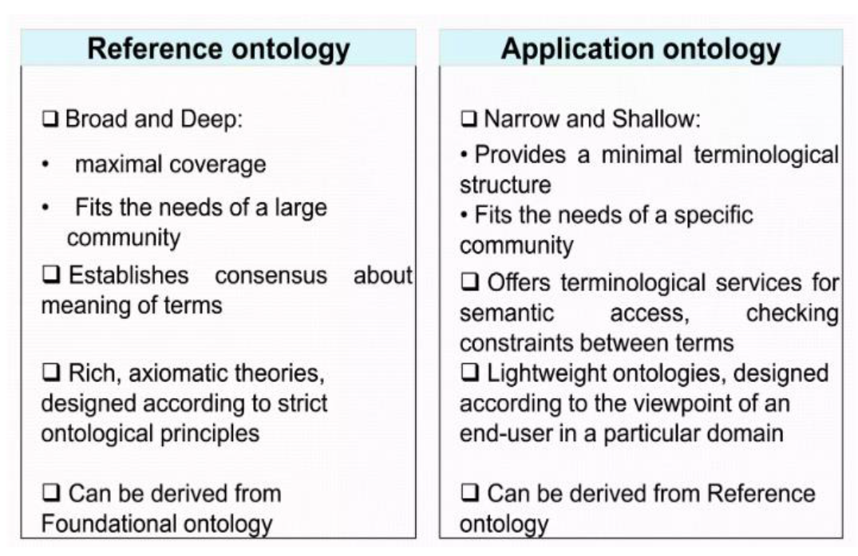

Slide 9
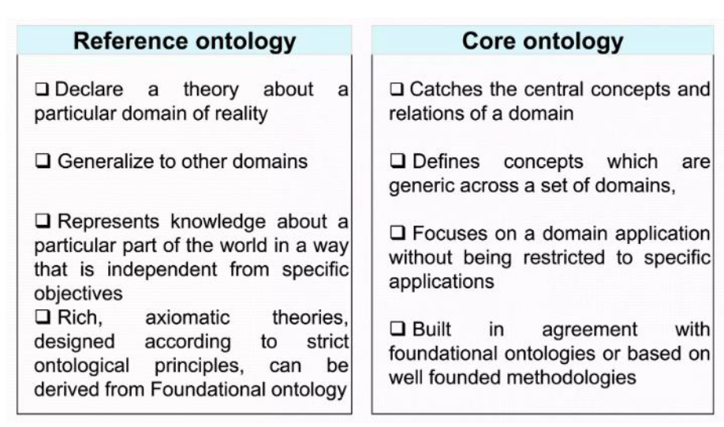

Slide 10
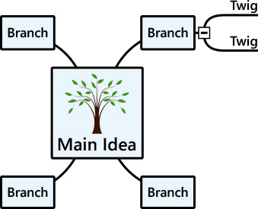
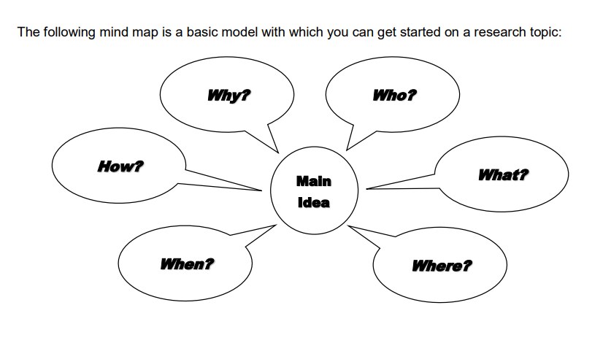
Mind mapping is an effective means to take notes and brainstorm essay topics.
A mind map involves writing down a central theme and thinking of new and related ideas that radiate out from the center.
By focusing on key ideas written down in your own words and looking for connections between them, you can map knowledge in a way that will help you to understand better and retain information.

Slide 11
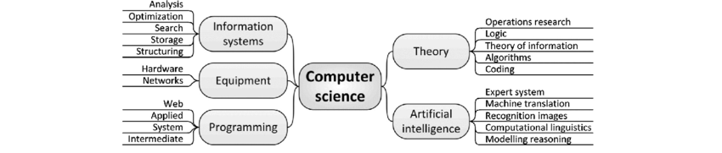

Slide 12
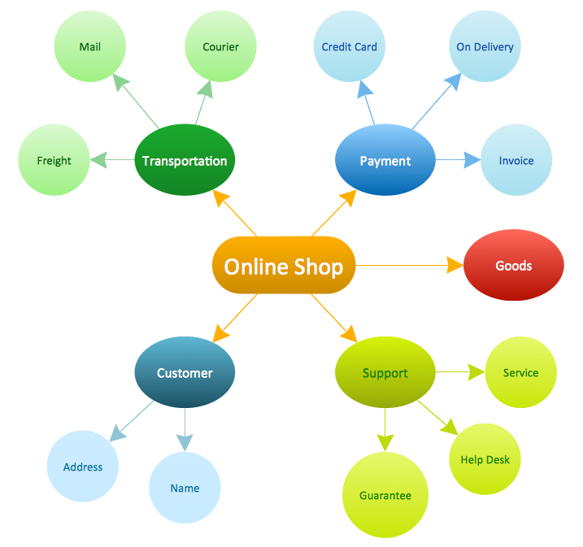
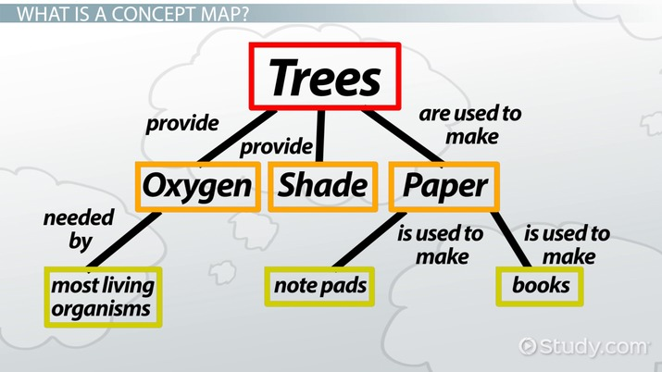

Slide 13
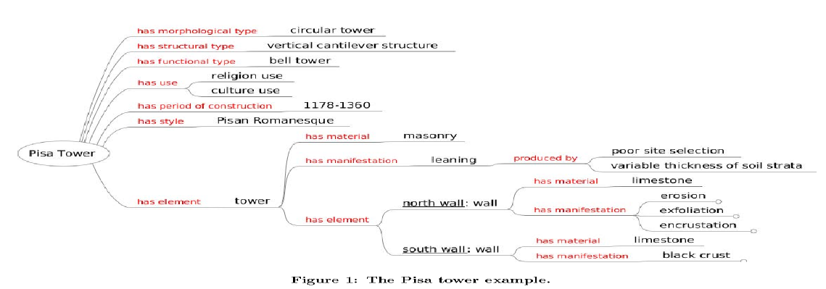

Slide 14
What are the benefits of using mind mapping?
In summary, they include:
Giving you an overview of a large subject/broad topic and allowing you to represent it in a more concise fashion
Encouraging you to see the bigger picture and creative pathways
Enabling you to plan/make choices about the selection of resource material you have for an assignment and where you are going to place it
Providing you with a more attractive and enjoyable format for your eye/brain to look at, muse over, and remember.
higher levels of concentration and creativity
Benefits
More concise communication
Greater organization

Slide 15
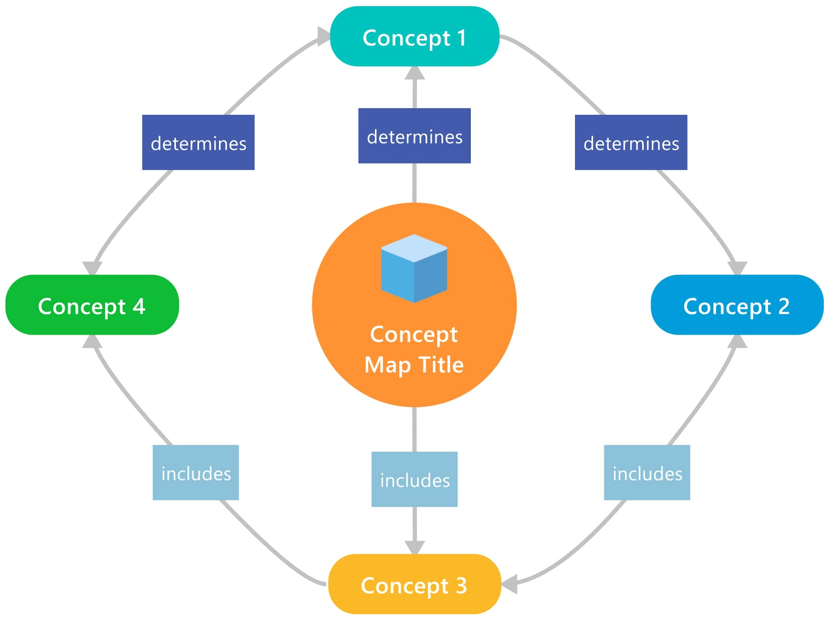
A concept map is a diagram or graphical tool that visually represents relationships between concepts and ideas. Most concept maps depict ideas as boxes or circles (also called nodes), which are structured hierarchically and connected with lines or arrows (also called arcs).
These lines are labeled with linking words and phrases to help explain the connections between concepts.

Slide 16
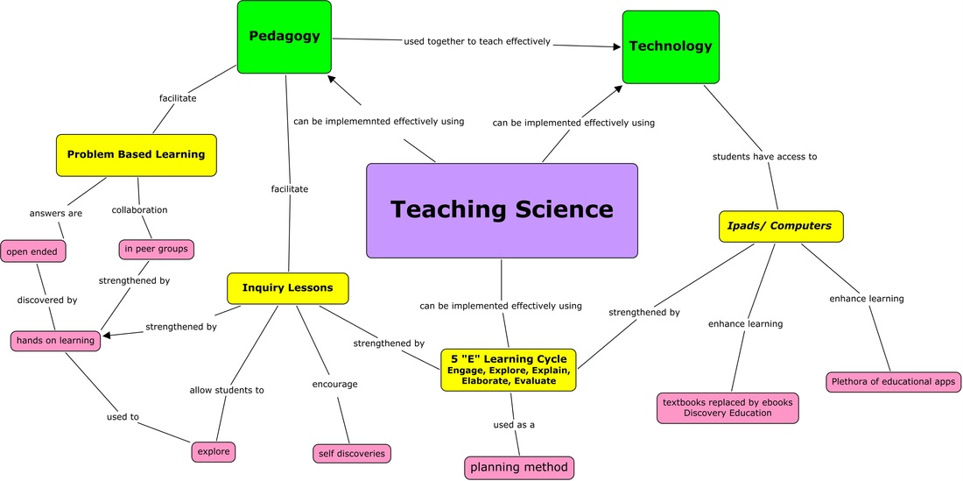

Slide 17
Why use a concept map?
The brain processes visuals 60,000 times faster than it processes text.
Designed as a tool to organize and represent knowledge, concept mapping can help you visualize relationships between various concepts and test your understanding of complex subjects.
Thinking through and visually representing relationships between ideas forms mental connections that allow for better retention of knowledge.
This diagram is a popular way to capture understanding of a topic for work, school, or personal study.

Slide 18
Concept mapping offers benefits for any learning process:
Facilitates comprehension with its visual format
Synthesizes information by integrating new and old concepts to grasp the big picture better
Encourages brainstorming and high-level thinking
Foster’s discovery of new concepts and their connections
Provides clear communication of complex ideas
Promotes collaborative learning
Sparks creativity
Snapshots your current knowledge to assess understanding
Identifies areas that need further knowledge or review

Slide 19
Making a concept map can be helpful when:
Presenting concise overviews of a field
Absorbing information while studying for an exam
Assessing a student’s grasp of a particular topic
Consolidating knowledge during the learning process
Demonstrating an acceptable level of understanding on a subject
Defining knowledge that exists in your head but hasn’t been formally documented

Slide 20
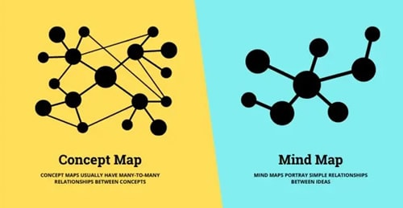
Concept maps vs. mind maps

Slide 21
Concept maps
Are used to represent tacit knowledge, like an existing theory or concept. The ideas are usually generated externally.
Tend to represent academic knowledge, so their application is more formal.
Contain general knowledge near the top of the map, with related concepts arranged hierarchically below.
Show topics with cross-linking and multiple relationships.
Mind maps
Are used to flesh out a set of ideas, which are often generated internally.
Tend to represent a greater variety of tasks and concepts, so their application is more flexible.
Contain a single word, phrase, or image in the center of the map, with related ideas radiating outward in all directions.
Show topics with a single parent and several children.

